Slide 1
DDoS(Distributed Denial-of-Service )
What is DDoS ?
How does a DDoS attack work?
How to Config a DDoS attack ?
FACULTY OF INFORMATION TECHNOLOGY
LÝ TỰ TRỌNG TECHNICAL COLLEGE HCM CITY

Slide 2
DDoS(Distributed Denial-of-Service )
What is DDoS ?
A distributed denial-of-service (DDoS) attack is a malicious attempt to disrupt normal traffic of a targeted server, service or network by overwhelming the target or its surrounding infrastructure with a flood of Internet traffic. DDoS attacks achieve effectiveness by utilizing multiple compromised computer systems as sources of attack traffic. Exploited machines can include computers and other networked resources such as IoT devices.
FACULTY OF INFORMATION TECHNOLOGY
LÝ TỰ TRỌNG TECHNICAL COLLEGE HCM CITY

Slide 3
DDoS(Distributed Denial-of-Service )
How does a DDoS attack work?
A DDoS attack requires an attacker to gain control of a network of online machines in order to carry out an attack. Computers and other machines (such as IoT devices) are infected with malware, turning each one into a bot (or zombie). The attacker then has remote control over the group of bots, which is called a botnet.
Once a botnet has been established, the attacker is able to direct the machines by sending updated instructions to each bot via a method of remote control. When the IP address of a victim is targeted by the botnet, each bot will respond by sending requests to the target, potentially causing the targeted server or network to overflow capacity, resulting in a denial-of-service to normal traffic. Because each bot is a legitimate Internet device, separating the attack traffic from normal traffic can be difficult.
FACULTY OF INFORMATION TECHNOLOGY
LÝ TỰ TRỌNG TECHNICAL COLLEGE HCM CITY

Slide 4
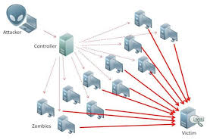
DDoS(Distributed Denial-of-Service )
How does a DDoS attack work?
FACULTY OF INFORMATION TECHNOLOGY
LÝ TỰ TRỌNG TECHNICAL COLLEGE HCM CITY

Slide 5
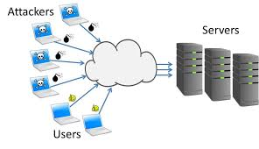
DDoS(Distributed Denial-of-Service )
How does a DDoS attack work?
FACULTY OF INFORMATION TECHNOLOGY
LÝ TỰ TRỌNG TECHNICAL COLLEGE HCM CITY

Slide 6
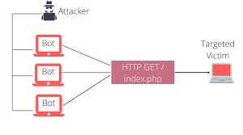
DDoS(Distributed Denial-of-Service )
How does a DDoS attack work?
FACULTY OF INFORMATION TECHNOLOGY
LÝ TỰ TRỌNG TECHNICAL COLLEGE HCM CITY

Slide 7
DDoS(Distributed Senial-of-Service )
Step 1: Set IP address
Step 2: Download http_load (https://acme.com/Software/http_load)
Step 3: Use nano utility to modify file version.h
Step 4: install http_load
Step 5: DDoS attack
Lets take a look this video !
FACULTY OF INFORMATION TECHNOLOGY
LÝ TỰ TRỌNG TECHNICAL COLLEGE HCM CITY

Slide 8
REPORTED BY Dương Ngọc Vọng
THANKS FOR WATCHING !
FACULTY OF INFORMATION TECHNOLOGY
LÝ TỰ TRỌNG TECHNICAL COLLEGE HCMC

